Slide 1
Linear Algebra and Web Search
An overview

Slide 2
Contents:
Representing documents(web pages) as vectors
Internet as web graph
Information retrieval with Vector Space Model
Extending VSM: Latent Semantic Indexing
Ranking web pages
Link analysis
HITS algorithm
Google PageRank algorithm
PageRank demo

Slide 3
Web Search Basics
Web Search consists of three underlying components:
Crawling and data acquisition
Offline processing
Online search and ranking

Slide 4
Representation of web and its documents

Slide 5
Internet as a graph
The internet can be considered a large collection of documents, called web pages
In terms of graph theory, such web pages from individual nodes
Nodes must contain at least one link to each other
These links are represented by directional arrows, which shows how a web page links to one or more different pages
Ultimately, the internet can be represented as a directed graph

Slide 6
Internet as a graph
A directed graph G = (V, E) consists of a finite set V, together with a subset E ⊆ V × V. The elements of V are the vertices of the graph, and the elements of E are the edges of the graph. An edge of a directed graph is an ordered pair [u, v] where u and v are the vertices of the graph.
We say that the vertex v is adjacent from the vertex u, and the vertex u is adjacent to the vertex v.
For simplification, let a web page not link to itself, thus forming a simple graph

Slide 7
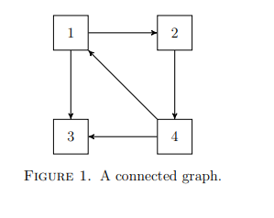
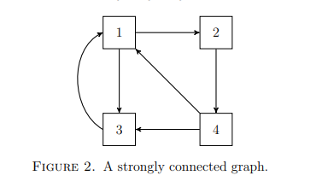
Internet as a graph
ϵ V, where V is set of web
pages
Link
Each node represents a page
Links represent ordered pair [u,v] where u and v are pages
Hyperlinks connect pages which forms basis for principles such as ordering, querying, and ranking for information retrieval

Slide 8
Modelling information as vectors
Web search is entirely dependent on modelling textual data in the form of vectors and matrices consisting of numerical values
Column vectors can be used to show what sort of content is contained in a particular document/page
A column vector represents a web page, and the N rows of the Nx1 matrix represent various aspects of information that may be relevant to a query
Also indicate the likelihood or probability of matching information to a search

Slide 9
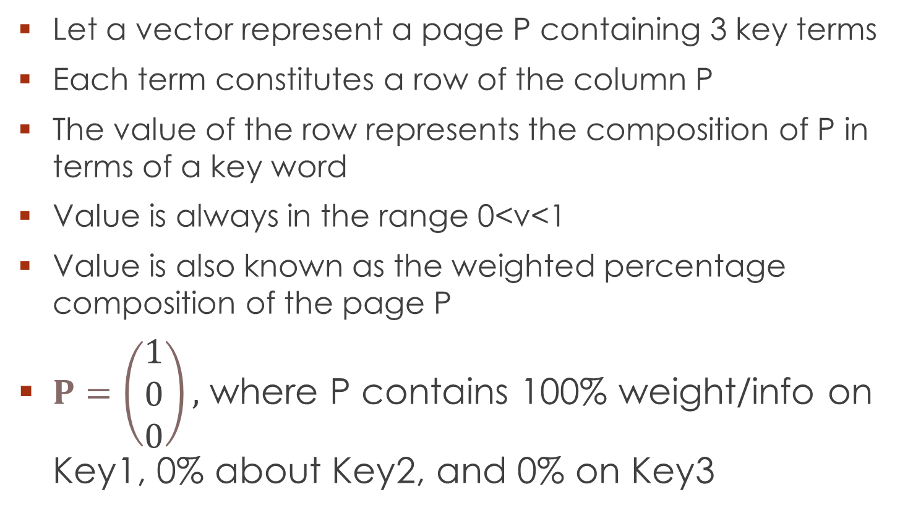
Modelling information as vectors
Let a vector represent a page P containing 3 key terms
Each term constitutes a row of the column P
The value of the row represents the composition of P in terms of a key word
Value is always in the range 0<v<1
Value is also known as the weighted percentage composition of the page P
$P=\left(\begin{matrix}1 \\ 0 \\ 0\end{matrix}\right),$ where P contains 100% weight/info on Key1, 0% about Key2, and 0% on Key3

Slide 10
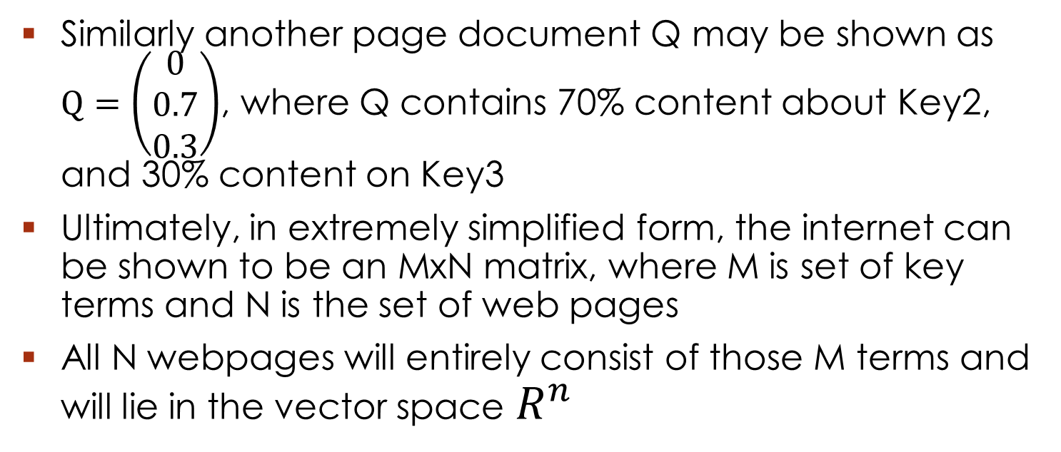
Modelling information as vectors
Similarly another page document Q may be shown as $Q=\left(\begin{matrix}0 \\ 0.7 \\ 0.3\end{matrix}\right)$, where Q contains 70% content about Key2, and 30% content on Key3
Ultimately, in extremely simplified form, the internet can be shown to be an MxN matrix, where M is set of key terms and N is the set of web pages
All N webpages will entirely consist of those M terms and will lie in the vector space $R^{n}$

Slide 11
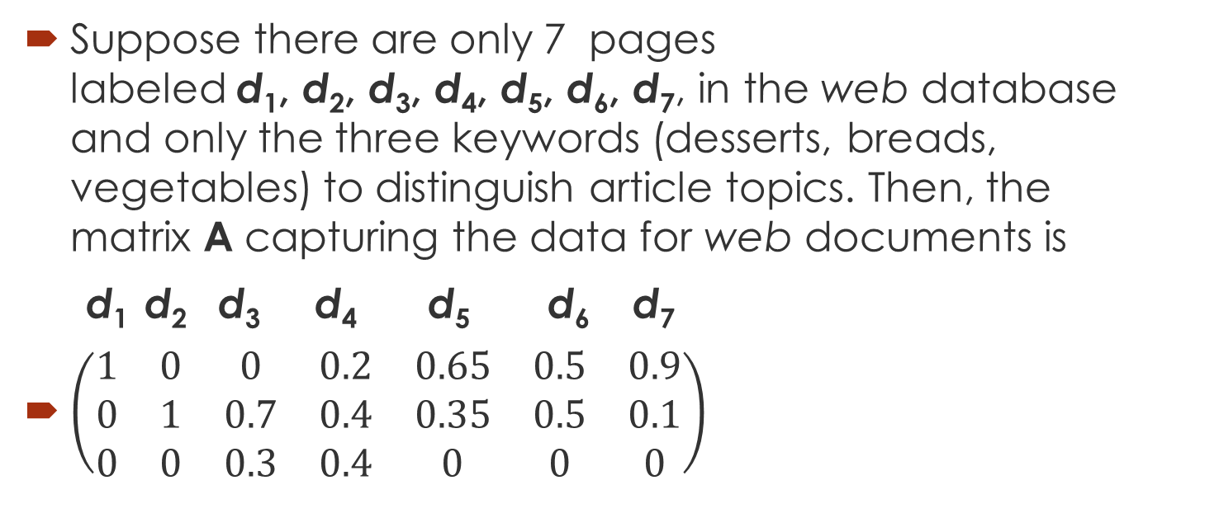
Modelling information as vectors
Suppose there are only 7 pages labeled d₁, d₂, d₃, d₄, d₅, d₆, d₇, in the web database and only the three keywords (desserts, breads, vegetables) to distinguish article topics. Then, the matrix A capturing the data for web documents is
d₁ d₂ d₃ d₄ d₅ d₆ d₇
$\left(\begin{matrix}1 & 0 & 0 & 0.2 & 0.65 & 0.5 & 0.9 \\ 0 & 1 & 0.7 & 0.4 & 0.35 & 0.5 & 0.1 \\ 0 & 0 & 0.3 & 0.4 & 0 & 0 & 0\end{matrix}\right)$

Slide 12
Ranking Web Pages
Once data has been queried, the search engine would return multiple pages relating to the query’s content
Such results would need to be displayed in some order, particularly with respect to how relevant a webpage is to the search
As the web is understood to be a connected digraph of such pages, an edge, or link, of the graph would show that page A is giving importance to page B. This would result in page A recommending/citing page B.
Considering all such webpages would be recommended by at least one other page, some pages will have more relevance to the search than others, thus paving way for hyperlink analysis

Slide 13
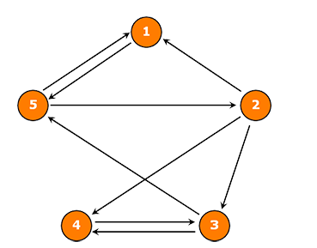
Consider Page 5, which has 2 outgoing links to Pages 1 and 2
Thus Page 5 is giving authority to those pages
The authority received by Page 1 and 2 will be weighted with respect to the total out degrees of Page 5
Thus, page 1 and 2 only receive ½ of the importance(1) of page 5
These pages can be combined to form a link matrix
Page 5 authorizes 1 and 2

Slide 14
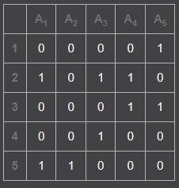

Original Adjacency Matrix
Adjacency matrix for previous graph shown
Each row represents a single page
Non zero entries represent a link from one page to another page
For example,
Page 2 (row 1) is linked to 3 pages: page 1 and page 3 and page 4 (check A)
Adjacency matrix shows relationships between one page and the other
The adjacency matrix for previous diagram

Slide 15
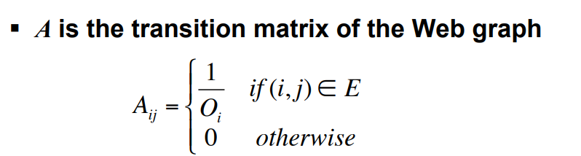



represents total number of out-links in a page(row sum of row i in matrix
represents a row entry(out-link) for some page i in matrix
The sum of every row of the matrix will be 1
Each row represents the out-links of a web page A
Sum of all entries for row i
Beginning from first page (column) till nth page (column)
As each entry = , sum will be equal to 1

Slide 16
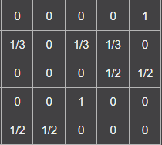


Link/Weighted Adjacency Matrix
The square link matrix for the graph can be shown as:
The NxN matrix represents the weighted links of pages
The row space spans the vector space representing outgoing links(citations)
The column space spans the vector space representing incoming links(citations)
Each row represents incoming links and each column represents outgoing links for nth page
For 3rd row will be: 1 (only 2 entries)
Row 3:

Slide 17

The Weighted Adjacency Matrix
Searching on the internet is a completely random process, where users can click any page unpredictably.
In that respect, the reason for normalization of the vectors is to estimate the probability of a user clicking on a particular webpage, relative to other pages within its network.
Probability of a visit is dependent on the last/current page accessed. Thus
For page 5, the user will have an equal probability of ½ of visiting other pages from the source page since page 5 only links to 2 of the 4 available pages in its network
Thus, each vector representing a page in the (inter)network forms a probability vector, whose entries will always sum up to 1 (shows probabilities of visit)
For page 2, there is an equal probability that pages 1, 3, and 4 will be accessed at any given time (importance is shared)

Slide 18

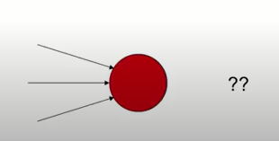
Page Walks
Browsers do random walks of pages
Start at random page
Go to the next out linked page from current page
Since there exist some nodes without out links, a single, long term state of probability for a page will be meaningless
For a particular node, there are two possibilities:
Has N>0 outgoing links:
Has no outgoing links:

Slide 19
Ranking Intuition
We are interested in the continuous transformation of the link matrix based on these probability vectors
This matrix transformation will result in some stable vector denoting the PageRanks of all pages in the graph
As the link matrix entirely consists of such probability vectors, it can be said that the link matrix of the network is a column stochastic matrix, or the transition probability matrix of the network

Slide 20
WHAT IF PAGES ARE UNLINKED? (DANGLING NODES)

Slide 21
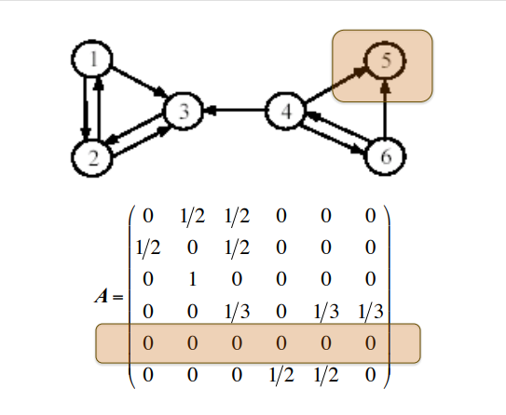
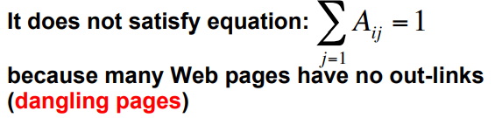
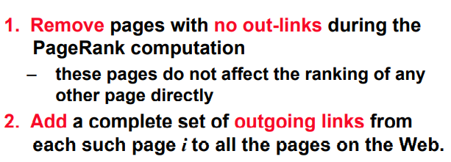
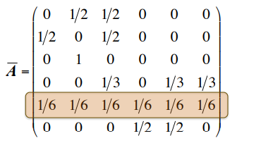
Dangling nodes
Row 5 is dangling node (zero vector)
Add 1/N to the zero vector. N=6 in this case. (number of pages)
Now row will sum to 1 again
Dangling node fixed

Slide 22
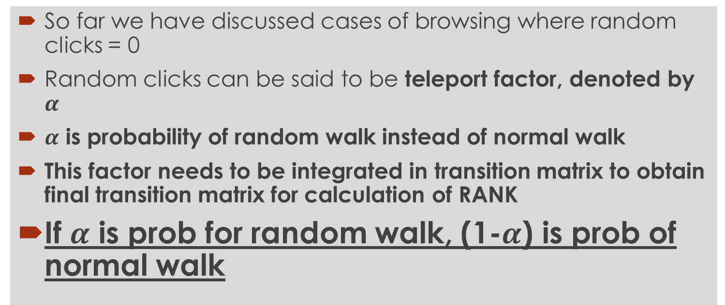
Randomness
So far we have discussed cases of browsing where random clicks = 0
Random clicks can be said to be teleport factor, denoted by $α$
$α$ is probability of random walk instead of normal walk
This factor needs to be integrated in transition matrix to obtain final transition matrix for calculation of RANK
If $α$ is prob for random walk, (1-$α$) is prob of normal walk

Slide 23
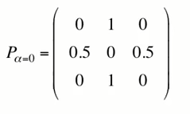


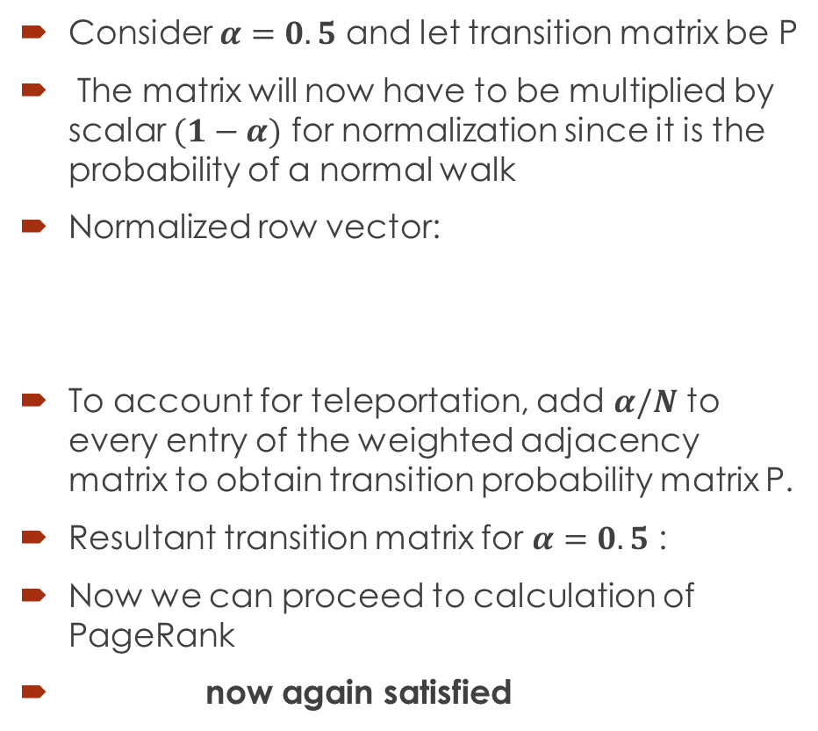
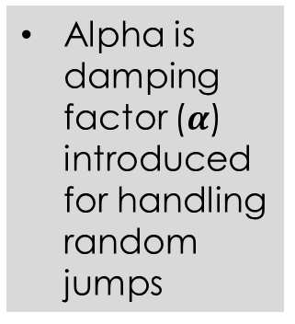
Computing probability
Alpha is damping factor ($α$) introduced for handling random jumps
Consider $α=0.5$ and let transition matrix be P
The matrix will now have to be multiplied by scalar $(1−α)$ for normalization since it is the probability of a normal walk
Normalized row vector:
To account for teleportation, add $α/N$ to every entry of the weighted adjacency matrix to obtain transition probability matrix P.
Resultant transition matrix for $α=0.5$ :
Now we can proceed to calculation of PageRank
now again satisfied
Initial weighted transition matrix for markov chain
Resultant normalized transition probability matrix

Slide 24


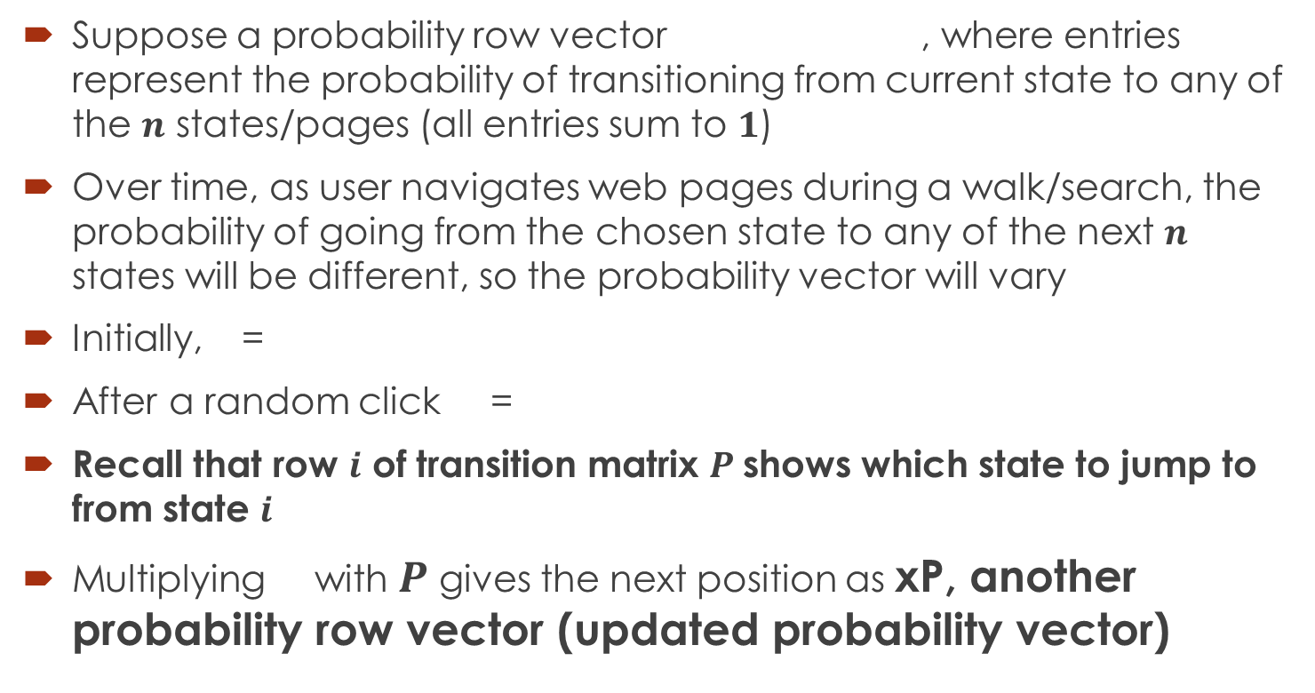
The Probability Vector
Suppose a probability row vector , where entries represent the probability of transitioning from current state to any of the $n$ states/pages (all entries sum to $1$)
Over time, as user navigates web pages during a walk/search, the probability of going from the chosen state to any of the next $n$ states will be different, so the probability vector will vary
Initially, =
After a random click =
Recall that row $i$ of transition matrix $P$shows which state to jump to from state $i$
Multiplying with $P$ gives the next position as xP, another probability row vector (updated probability vector)

Slide 25

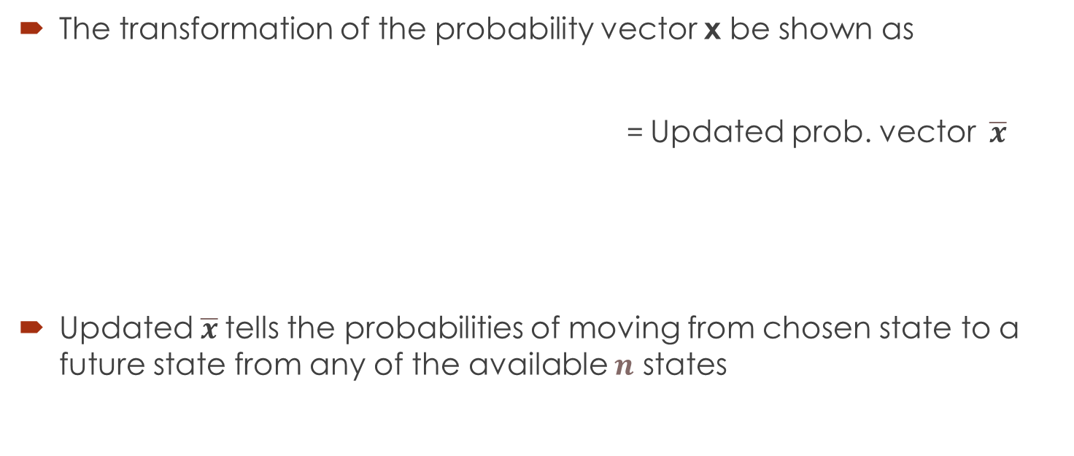

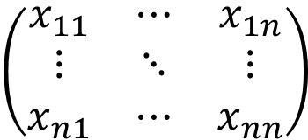
Transformation
The transformation of the probability vector x be shown as
= Updated prob. vector$\overline{x}$
Updated $\overline{x}$tells the probabilities of moving from chosen state to a future state from any of the available $n$ states
$$\left(\begin{matrix}x_{11} & ⋯ & x_{1n} \\ ⋮ & ⋱ & ⋮ \\ x_{n1} & ⋯ & x_{nn}\end{matrix}\right)$$
$$P$$

Slide 26
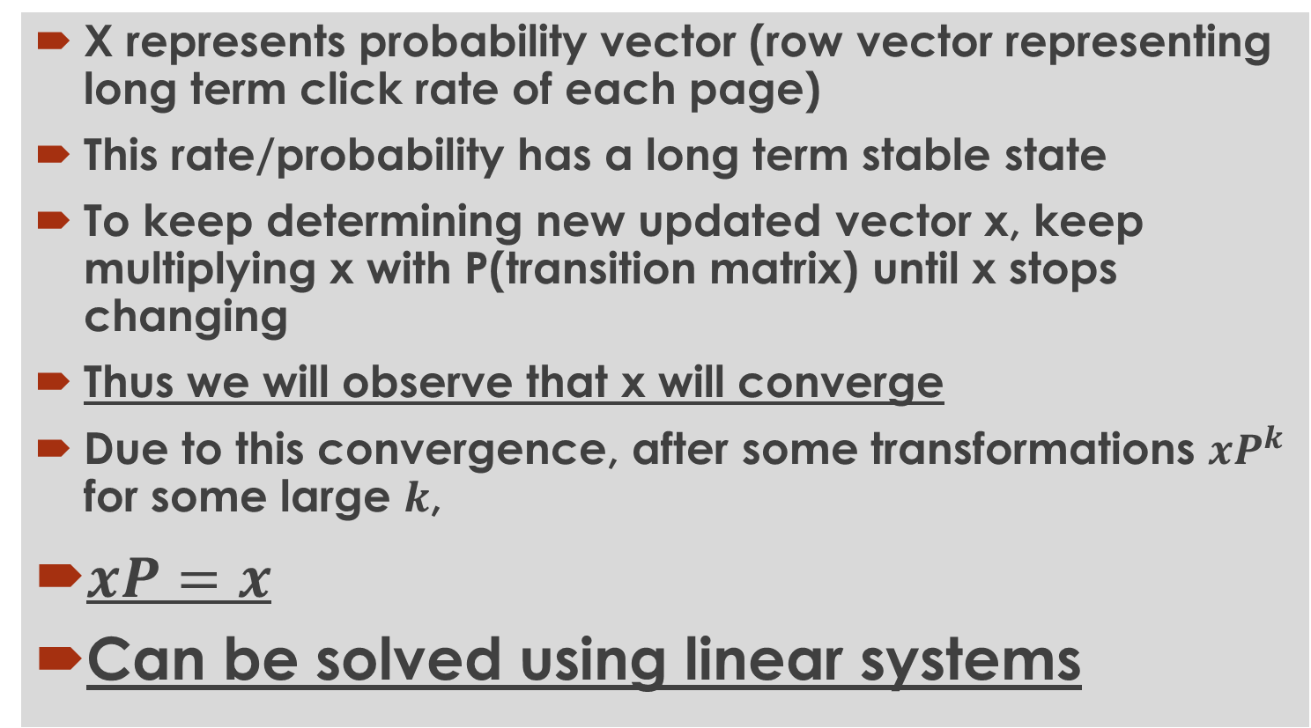
Solving for PageRank
X represents probability vector (row vector representing long term click rate of each page)
This rate/probability has a long term stable state
To keep determining new updated vector x, keep multiplying x with P(transition matrix) until x stops changing
Thus we will observe that x will converge
Due to this convergence, after some transformations $xP^{k}$ for some large $k$,
$xP=x$
Can be solved using linear systems

Slide 27
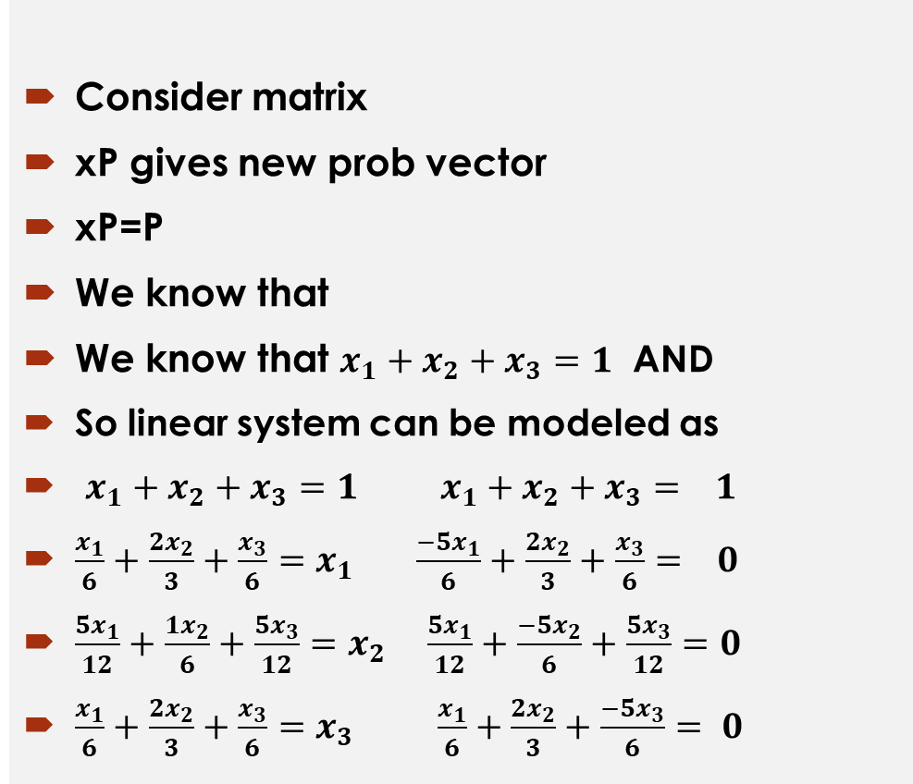
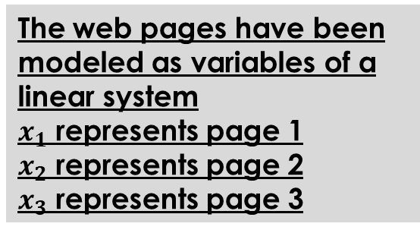

Value of PageRank
Consider matrix
xP gives new prob vector
xP=P
We know that
We know that $x_{1}+x_{2}+x_{3}=1$ AND
So linear system can be modeled as
$x_{1}+x_{2}+x_{3}=1$ $x_{1}+x_{2}+x_{3}= 1$
$\frac{x_{1}}{6}+\frac{{2x}_{2}}{3}+\frac{x_{3}}{6}=x_{1}$ $\frac{{−5x}_{1}}{6}+\frac{{2x}_{2}}{3}+\frac{x_{3}}{6}= 0$
$\frac{{5x}_{1}}{12}+\frac{{1x}_{2}}{6}+\frac{{5x}_{3}}{12}=x_{2}$ $\frac{{5x}_{1}}{12}+\frac{{−5x}_{2}}{6}+\frac{{5x}_{3}}{12}=0$
$\frac{x_{1}}{6}+\frac{{2x}_{2}}{3}+\frac{x_{3}}{6}=x_{3}$ $\frac{x_{1}}{6}+\frac{{2x}_{2}}{3}+\frac{{−5x}_{3}}{6}= 0$
The web pages have been modeled as variables of a linear system
$x_{1}$ represents page 1
$x_{2}$ represents page 2
$x_{3}$ represents page 3
$$xP=x$$
Solution of the system will contain PageRanks for the web pages represented as variables

Slide 28
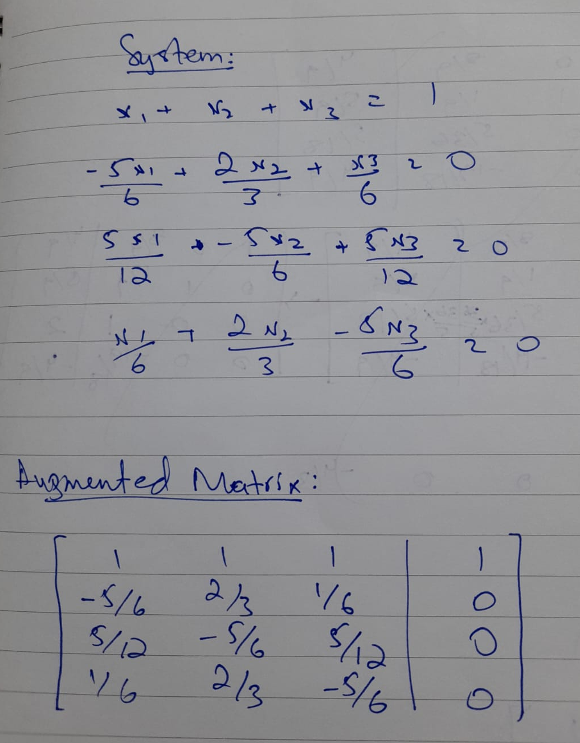
Solution
USING GAUSS JORDAN ELIMINATION:

Slide 29
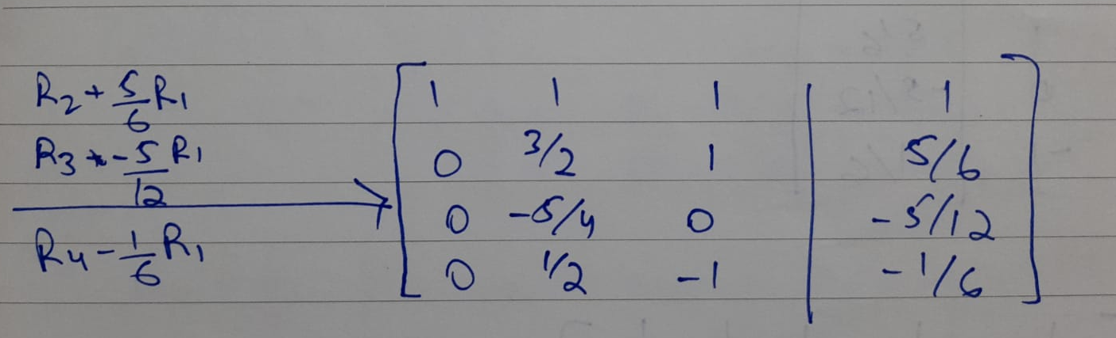
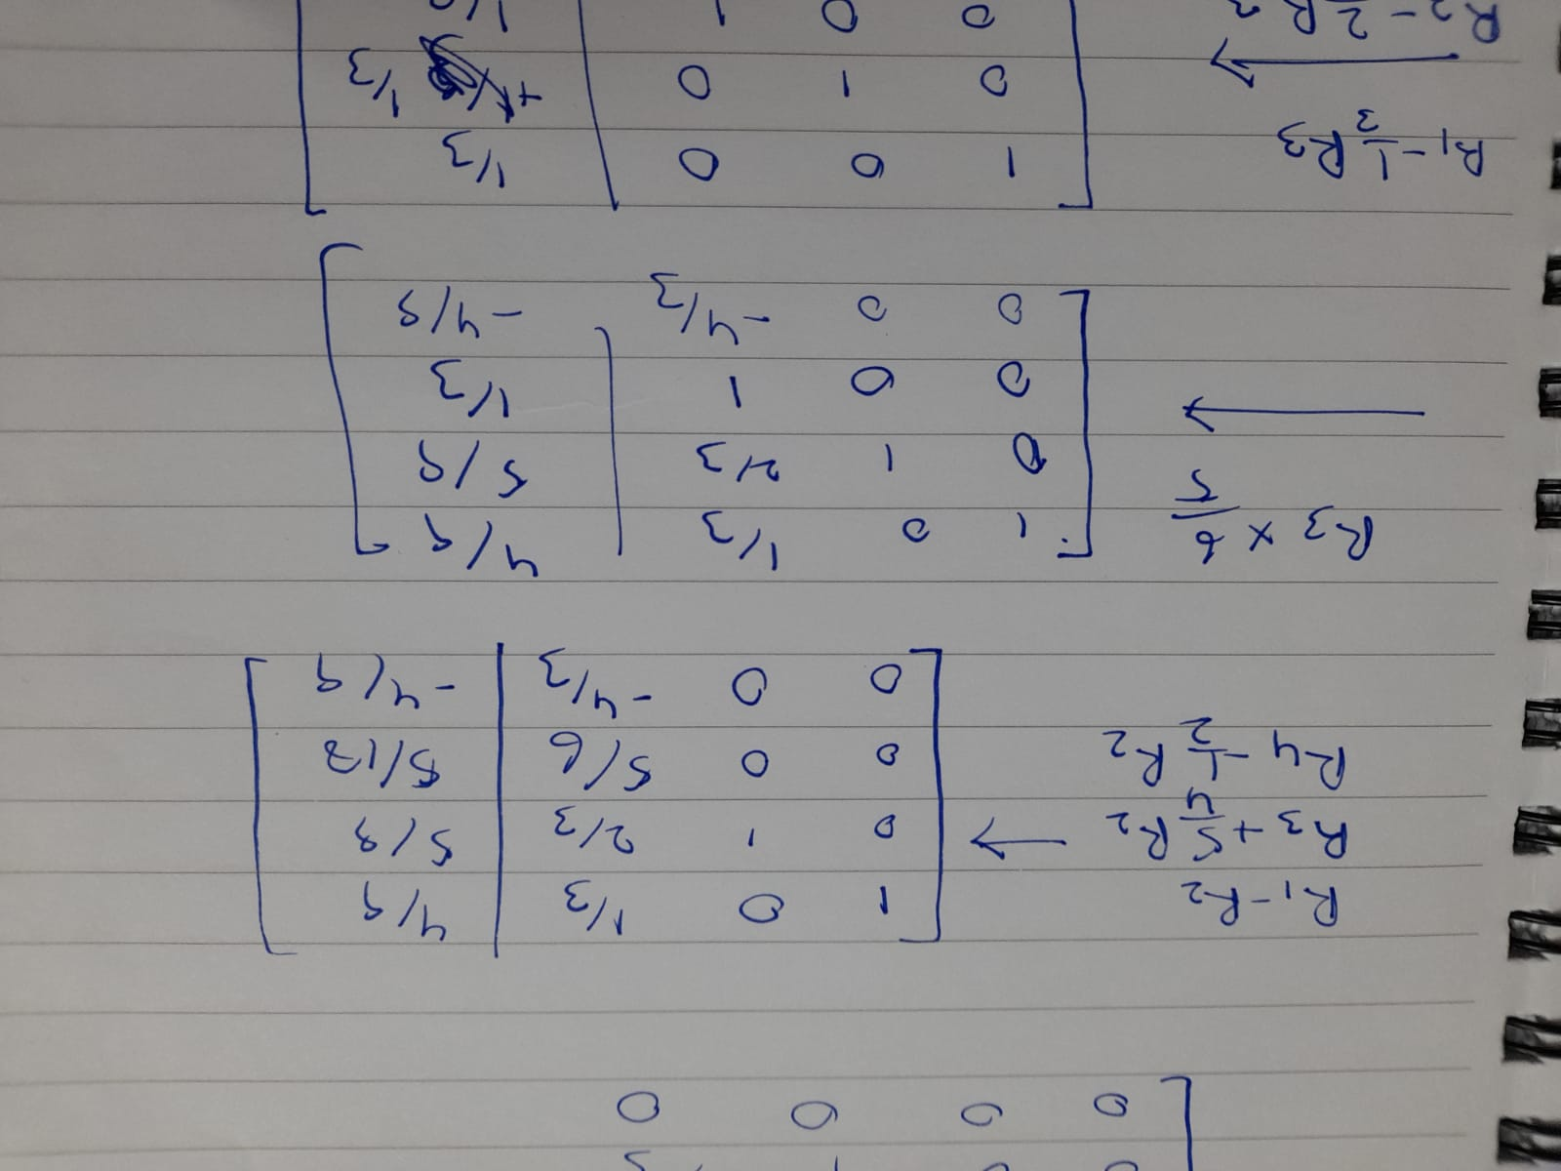
Step 2
Step 3 and Step 4

Slide 30
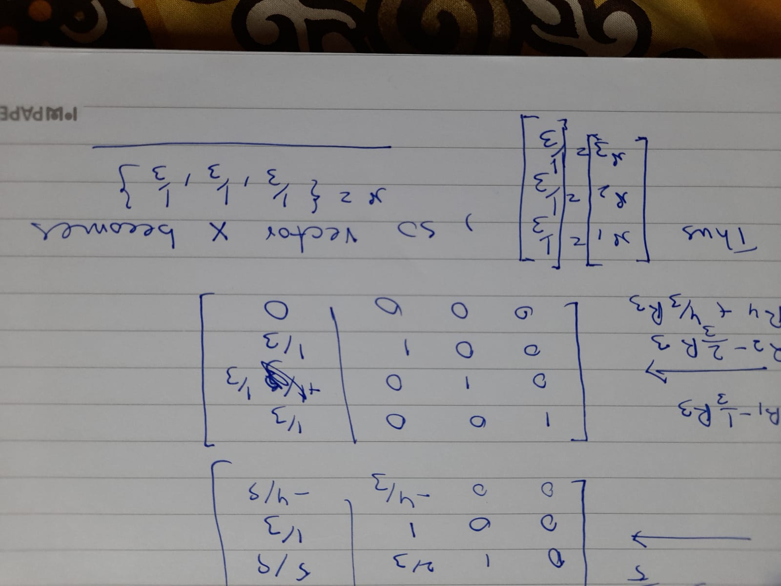
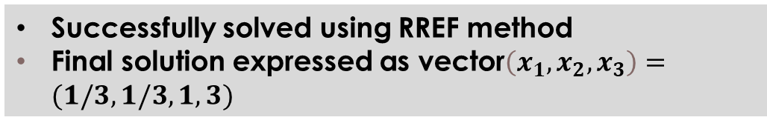
Step 5
Successfully solved using RREF method
Final solution expressed as vector$\left(x_{1},x_{2},x_{3}\right)=(1/3,1/3,1,3)$

Slide 31
Page Rank Conclusion
Node 1 Rank: 1/3
Node 2 Rank: 1/3
Node 3 Rank: 1/3
Thus Nodes displayed with the same order/rank
Order:
Page 1 (1/3)
Page 2 (1/3)
Page 3 (1/3)
Order is always query independent
Can be incorporated with information retrieval algorithms like those based on previously discussed vector space model (VSM) algorithms

Slide 32
Introduction to vector space model
Vector space models are to consider the relationship between data that are represented by vectors. It is popular in information retrieval systems but also useful for other purposes. Generally, this allows us to compare the similarity of two vectors from a geometric perspective.
A vector space is a mathematical term that defines some vector operations. In layman’s term, we can imagine it is a n-dimensional metric space where each point is represented by a n-dimensional vector. In this space, we can do any vector addition or scalar-vector multiplications.

Slide 33
Definition and uses
The Vector-Space Model (VSM) for Information Retrieval represents documents and queries as vectors of weights. Each weight is a measure of the importance of an index term in a document or a query, respectively.
USES
information filtering
information retrieval
indexing
relevancy rankings

Slide 34
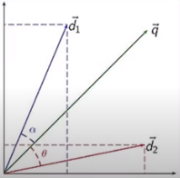
MORE ON VSM
As it is used in information retrieval to determine which document d1 or d2 is more similar to given query q.
Note that documents and queries are represented in the same space.
The angle between the two vectors (cosine similarity) is used as a proxy for the similarities of underlying documents.

Slide 35


Cosine Similarity
The cosine measured is computed as the normalized dot product of the two vectors:
A variant of cosine is the Jaccard coefficient:

Slide 36


Example
Q) What is cosine similarity between D={cat,dog,dog}= <1,2,0> and Q={cat,dog,mouse,mouse} =<1,1,2>
ANS:
COMPARISION:
NOTE: In general the cosine function has range of [-1,1], however when vectors are in first quadrant the range is [0,1].

Slide 37
Practical example
A document entitled "Will Shaq's Free Throws Stop the Lakers" might designate basketball, playoffs, and NBA as its keywords. This document's vector contains three 1's in the positions corresponding to its three keywords and 0's elsewhere. Search engines often apply weighting schemes to keywords. The scheme just described is unweighted, since each keyword gets the value 1 in the document vector. However, in a weighted scheme, the NBA playoff document might give more weight to playoff than basketball, and thus the entry corresponding to playoff might be 5 and the entry for basketball might be 2.

Slide 38
Latent Semantic Index
Latent semantic analysis (LSA) is a technique in natural language processing, in particular distributional semantics, of analyzing relationships between a set of documents and the terms they contain by producing a set of concepts related to the documents and terms.
Main Idea
Map each documents into some concepts.
Map each term into some concepts.
Concept :- A set of terms, with weight

Slide 39
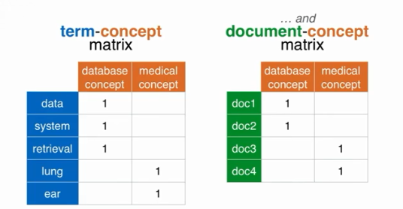
Latent Semantic Index
LSI can decompose our initial matrix into two smaller matrix.
Term-concept matrix
Document-concept matrix
The ‘1’s represent the weights of a concept in both the tables

Slide 40
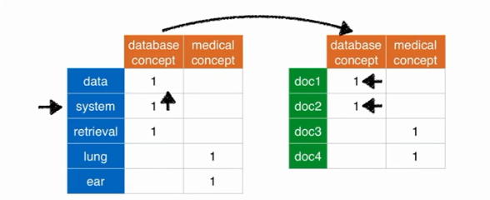
Latent Semantic Index
Q: How to search, for eg for “system”?
ANS: Find the corresponding concepts and its documents .(works like an automatic constructed thesaurus).

Slide 41
Benefits of LSI
To derive concepts from documents.
Works as an automatic thesaurus .
Reduce dimensionality down to fewer concepts.(matrix decomposition)
More benefits of LSI:-
LSI is not restricted to working only with words. It can also process arbitrary character strings. Any object that can be expressed as text can be represented in an LSI vector space. For example, tests with MEDLINE abstracts have shown that LSI is able to effectively classify genes based on conceptual modeling of the biological information contained in the titles and abstracts of the MEDLINE citations.
Text does not need to be in sentence form for LSI to be effective. It can work with lists, free-form notes, email, Web-based content, etc. As long as a collection of text contains multiple terms, LSI can be used to identify patterns in the relationships between the important terms and concepts contained in the text.

Slide 42
How does LSI work (SVD)
LSI uses SVD (single value decomposition) which is mathematic tool. It finds concepts in matrices. Moreover, SVD can solve through finding these concepts we can ran these concepts and throw away the less important data, so that data is stored more efficiently.
It is a generalized technique and can manipulate any kind of data, All it takes is a matrix in rows and columns regardless of the content for eg:-Netflix/movies and grocery/items etc.

Slide 43
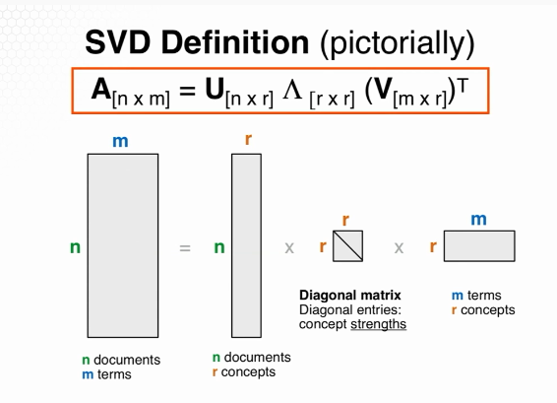
SVD (Definition and formula)
A: n x m matrix (n documents and m terms)
U: n x r matrix (n documents and r concepts)
^: r x r diagonal matrix (r ran of matrix and r strength of matrix)
V: m x r matrix (m terms and r concepts)

Slide 44
WHAT IS LINK ANALYSIS?
link analysis is a data analysis technique used to evaluate relationships (connections) between nodes. Relationships may be identified among various types of nodes (objects), including organizations , people and transactions
Normally, the nodes represent specific data points, and the links represent the connections between them

Slide 45
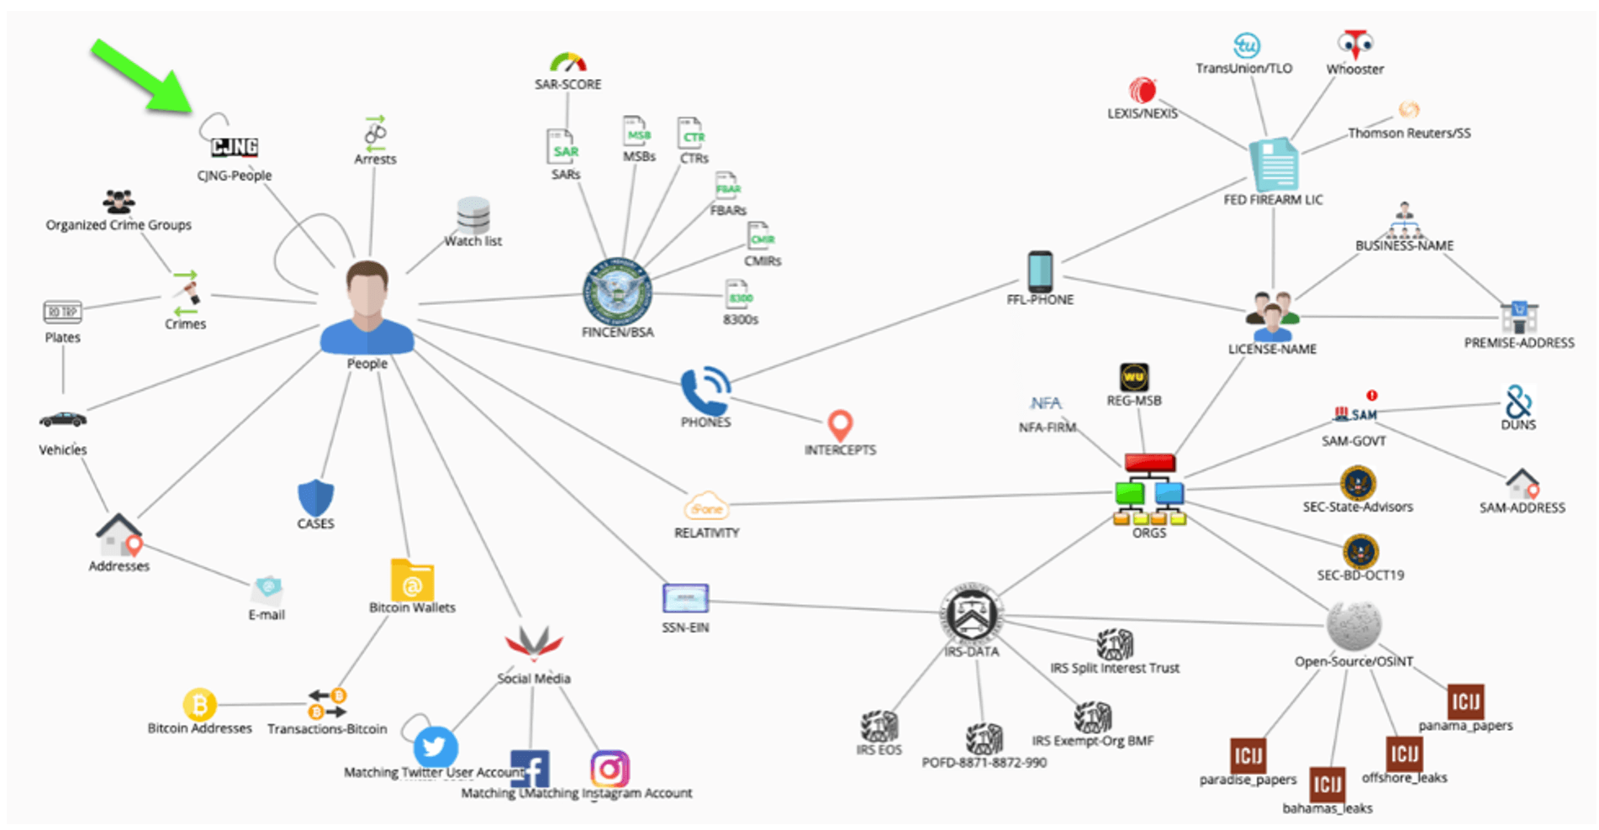
Example of how link analysis is used data analysis

Slide 46
WHERE IS LINK ANALYSIS USED?
Main use of link analysis is for extracting or analyzing huge pieces of data/information . It is used in all professional organizations .
Some of the basic uses of link analysis are:
To find matches in data for known patterns of interest
Find anomalies where known patterns are violated
Discover new patterns of interest.(used heavily for data mining)

Slide 47
Link analysis has been used for investigation of criminal activity (fraud detection, counterterrorism, and intelligence) to help police know the previous history of criminals etc
Its used in computer security analysis, search engine optimization (also used in google to provide user relevant information from huge chunks of data) market research(data mining), medical research, art etc.

Slide 48
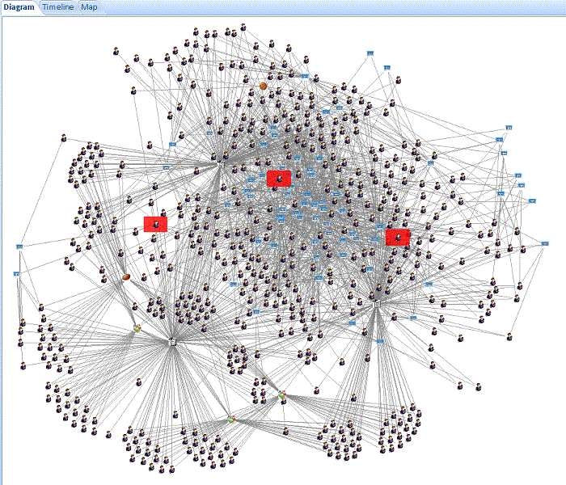
Link analysis is useful for analytical applications that rely on graph theory for drawing conclusions. One example is looking for closely connected groups of people

Slide 49
Hyperlink Induced Topic Search (HITS) Algorithm
Hyperlink Induced Topic Search (HITS) Algorithm is a Link Analysis Algorithm that rates webpages, developed by Jon Kleinberg. This algorithm is used to the web link-structures to discover and rank the webpages relevant for a particular search.
HITS uses hubs and authorities to define a recursive relationship between webpages.
Given a query to a Search Engine, the set of highly relevant web pages are called Roots. They are potential Authorities.
Pages that are not very relevant but point to pages in the Root are called Hubs. Thus, an Authority is a page that many hubs link to whereas a Hub is a page that links to many authorities.

Slide 50
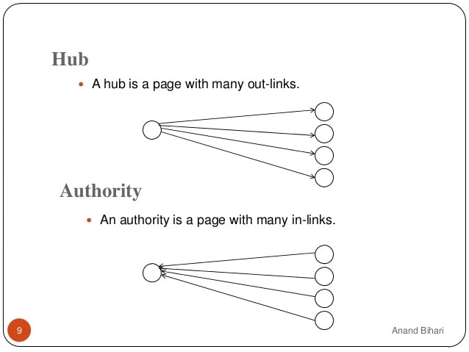
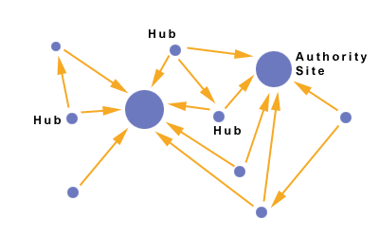

Slide 51
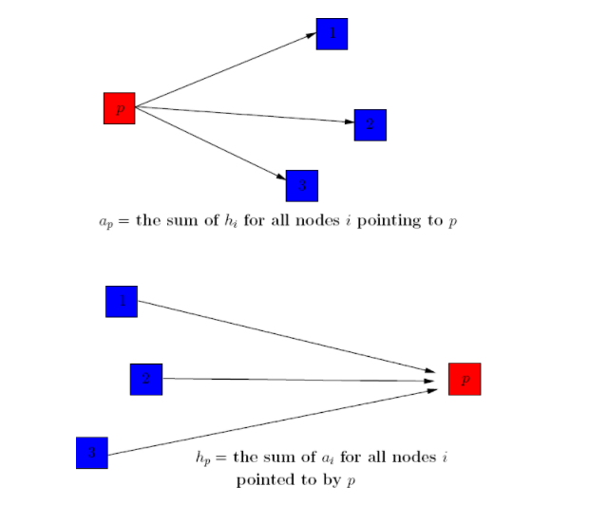
Algorithm
The algorithm performs a series of iterations, each consisting of two basic steps:
Authority update: The new authority is the sum of the hub of its parents
Hub update: The new hub is the sum of the authority of its children

Slide 52
The Hub score and Authority score for a node is calculated with the following algorithm:
Start with each node having a hub score and authority score of 1.
Run the authority update rule
Run the hub update rule
Normalize the values by dividing each Hub score by square root of the sum of the squares of all Hub scores, and dividing each Authority score by square root of the sum of the squares of all Authority scores.

Slide 53
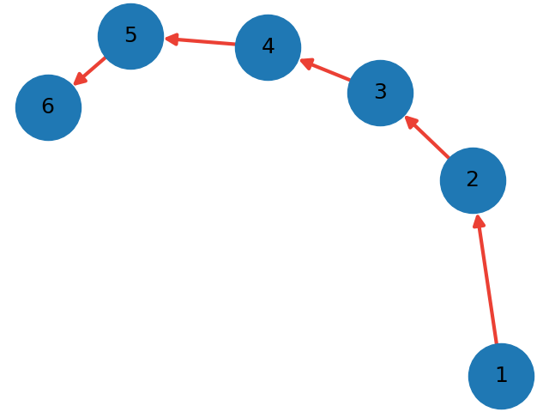
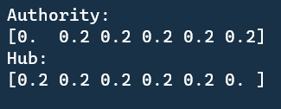
Example
The authority of node 1 is 0
The hub of node 6 is 0

Slide 54
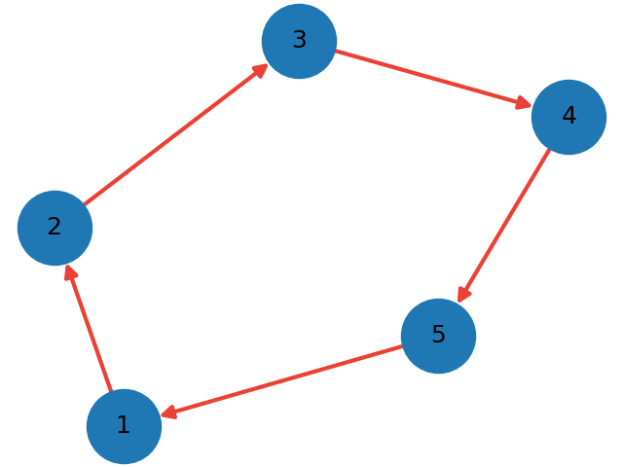
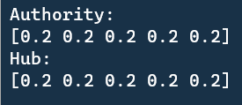
Example
The nodes form a cycle
They all have same authority and hub value

Slide 55
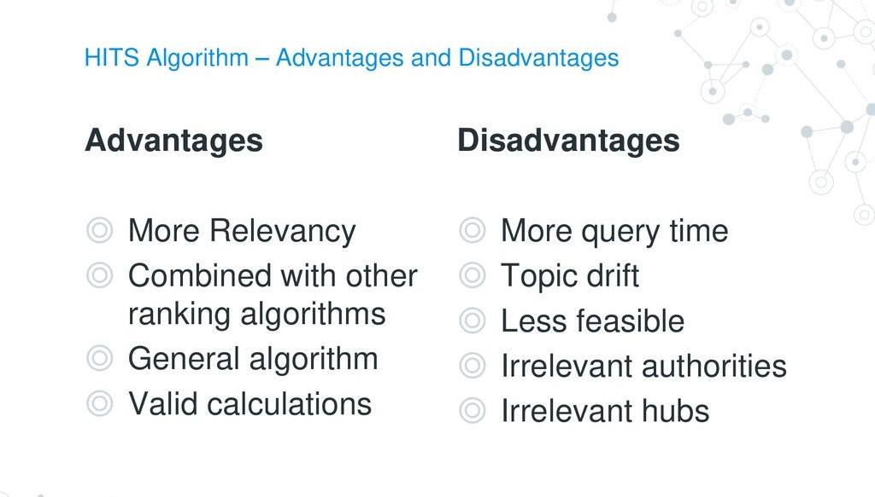

Slide 56
PAGERANK DEMONSTRATION
Demo attached in the project’s repository
Video explanation attached as well

Slide 57
References

Slide 58
linear algebra - Why is PageRank an eigenvector problem? - Mathematics Stack Exchange
The Linear Algebra Behind Search Engines - Introduction | Mathematical Association of America (maa.org)
Search engines and linear algebra - Nibcode Solutions
[PDF] The Use of the Linear Algebra by Web Search Engines | Semantic Scholar
Web Search Algorithms and PageRank (wlu.ca)
PageRank Algorithm - The Mathematics of Google Search (cornell.edu)

Slide 59
THANK YOU

